Slide 1



Final project
AI/machine learning
N a m e : N g u y e n Va n H a n ID : 2021214524
S c hool of M e c ha ni c a l a nd A e ros pa c e E ngi ne e ri ng G y e ongs a ng N a t i ona l U ni ve rs i t y

Slide 2
Image classification with CNN and Flask
Introduction to image classification CNN
Data preparation 3. Make a CNN model and train model
4. Evaluating the performance of a CNN model
5. Develop Web Application with Flask
6. Conclusion

Slide 3
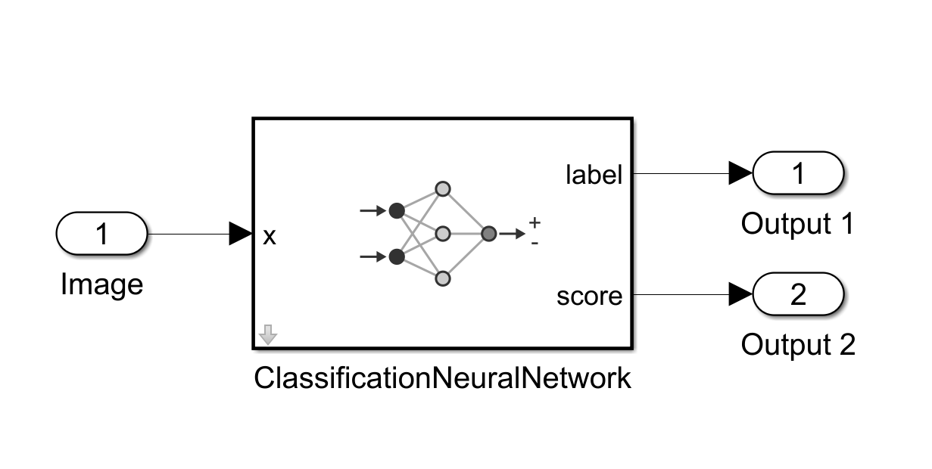
1. Introduction to image classification CNN
Image classification is a task in which an algorithm is trained to identify the class or category of an input image.
A CNN consists of multiple layers of interconnected nodes. The layers can be broadly classified into three types:
Convolutional layers: extract feature by using filters
Pooling layers: down-sampling
Fully-connected layers: classify the input image into classes

Slide 4


2. Training flow
Data Pre-processing
Images Data
Train
Machine Learning Model
Detect Face
Structure Images
& Labelling
► Detect Faces using
Haar Cascade Classifier
► Crop Faces from Images
► Label Each Image
► Unstructured dimension of cropped images to structured image dimension
► OpenCV resize module to make structure

Slide 5
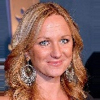
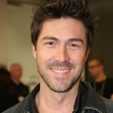
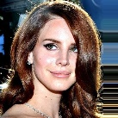

2. Training flow
Data preparation
Data Pre-processing
Images Data
Train
Machine Learning Model
Detect Face
Structure Images
& Labelling
► Detect Faces using
Haar Cascade Classifier
► Crop Faces from Images
► Label Each Image
► Unstructured dimension of cropped images to structured image dimension
► OpenCV resize module to make structure

Slide 6
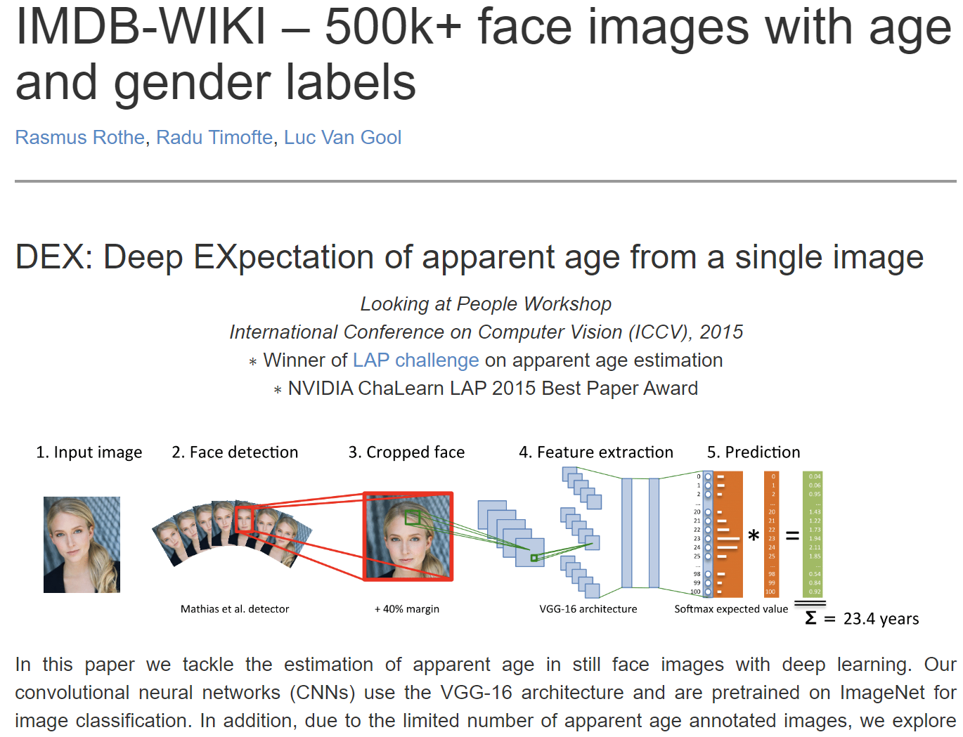

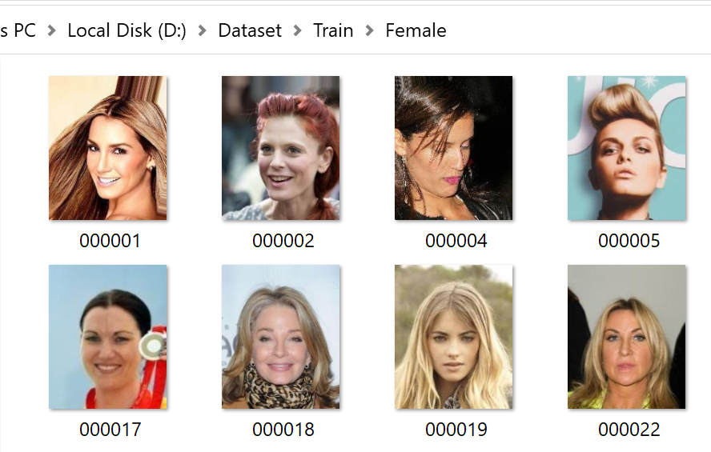
2. Training flow
Data preparation
Dataset: IMDB WIKI 500K+ face images
Total training images = 160000
Data for testing is 2000 images
https://data.vision.ee.ethz.ch/cvl/rrothe/imdb-wiki/

Slide 7
2. Training flow
Data preparation
Data Pre-processing
Images Data
Train
Machine Learning Model
Detect Face
Structure Images
& Labelling
► Detect Faces using
Haar Cascade Classifier
► Crop Faces from Images
► Label Each Image
► Unstructured dimension of cropped images to structured image dimension
► OpenCV resize module to make structure

Slide 8
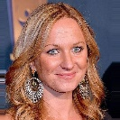


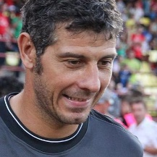
2. Training flow
Data processing
Data Pre-processing
Images Data
Train
Machine Learning Model
Detect Face
Structure Images
& Labelling
► Detect Faces using
Haar Cascade Classifier
► Crop Faces from Images
► Label Each Image
► Unstructured dimension of cropped images to structured image dimension
► OpenCV resize module to make structure

Slide 9
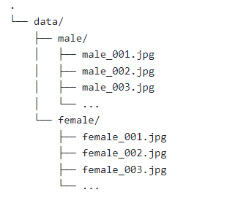
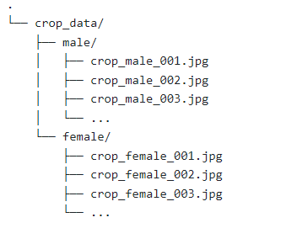
2. Training flow
Data processing
Original Data
Cropped Faces Data
Images Data
Detect Face
► Detect Faces using
Haar Cascade Classifier
► Crop Faces from Images
► Label Each Image
Refer example code cv2 module from lecture resource to detect face then crop face area.
- step-1: Read Image
- step-2: Apply haar cascade classifier
- step-3: Crop face using coordinates from cascade classifier
- step-4: save image in respective directory/folder

Slide 10


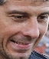
2. Training flow
Data processing
Data Pre-processing
Images Data
Train
Machine Learning Model
Detect Face
Structure Images
& Labelling
► Detect Faces using
Haar Cascade Classifier
► Crop Faces from Images
► Label Each Image
► Unstructured dimension of cropped images to structured image dimension
► OpenCV resize module to make structure

Slide 11
2. Training flow
Data processing
Images Data
Detect Face
Structure Images
& Labelling
Idea is to convert all images into same size
► Detect Faces using
Haar Cascade Classifier
► Crop Faces from Images
► Label Each Image
► Unstructured dimension of cropped images to structured image dimension
► OpenCV resize module to make structure

Slide 12
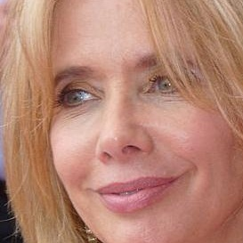
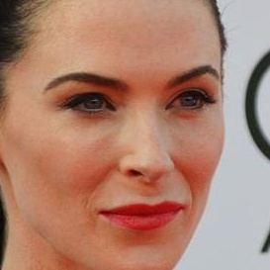


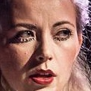
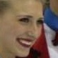
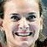
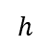
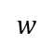
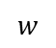
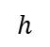
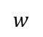
2. Training flow
Data processing
$$w$$
$$w$$
$$h$$
$$h$$
$$w$$
$$w$$
$$w$$
$$h$$
$$h$$
$$h$$
Idea is to convert all images into same size
h=w =250 [pixel]

Slide 13
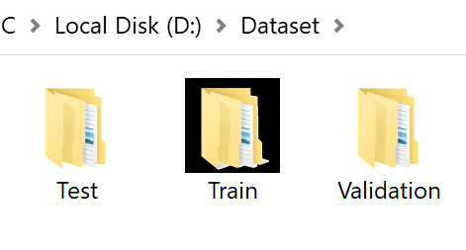
2. Training flow
Data processing
The data was separate into 3 folders.
70% for training
30% for validation
10% for testing

Slide 14
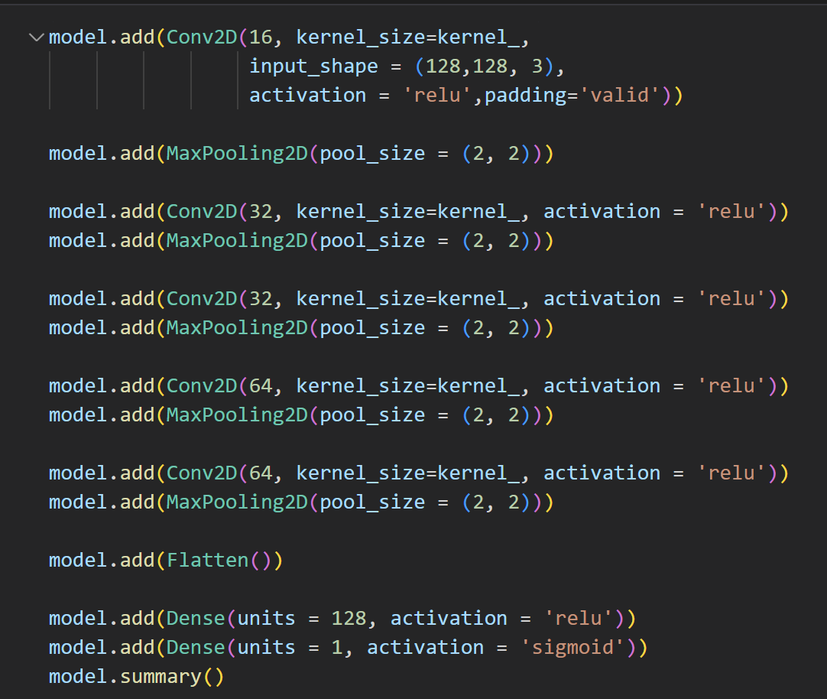
3. Make a CNN model and train model
Define model
Total 12 layers.
A 2D convolutional layer with 16 filters.
A 2D max pooling layer with a pool size of (2, 2).
A 2D convolutional layer with 32 filters.
A 2D max pooling layer with a pool size of (2, 2).
A 2D convolutional layer with 32 filters.
A 2D max pooling layer with a pool size of (2, 2).
A 2D convolutional layer with 64 filters
A 2D max pooling layer with a pool size of (2, 2).
A 2D convolutional layer with 64 filters.
A 2D max pooling layer with a pool size of (2, 2).
A flatten layer. (Don’t consider as a layer)
A dense (fully connected) layer with 128 units
A dense (fully connected) layer with 1 unit

Slide 15
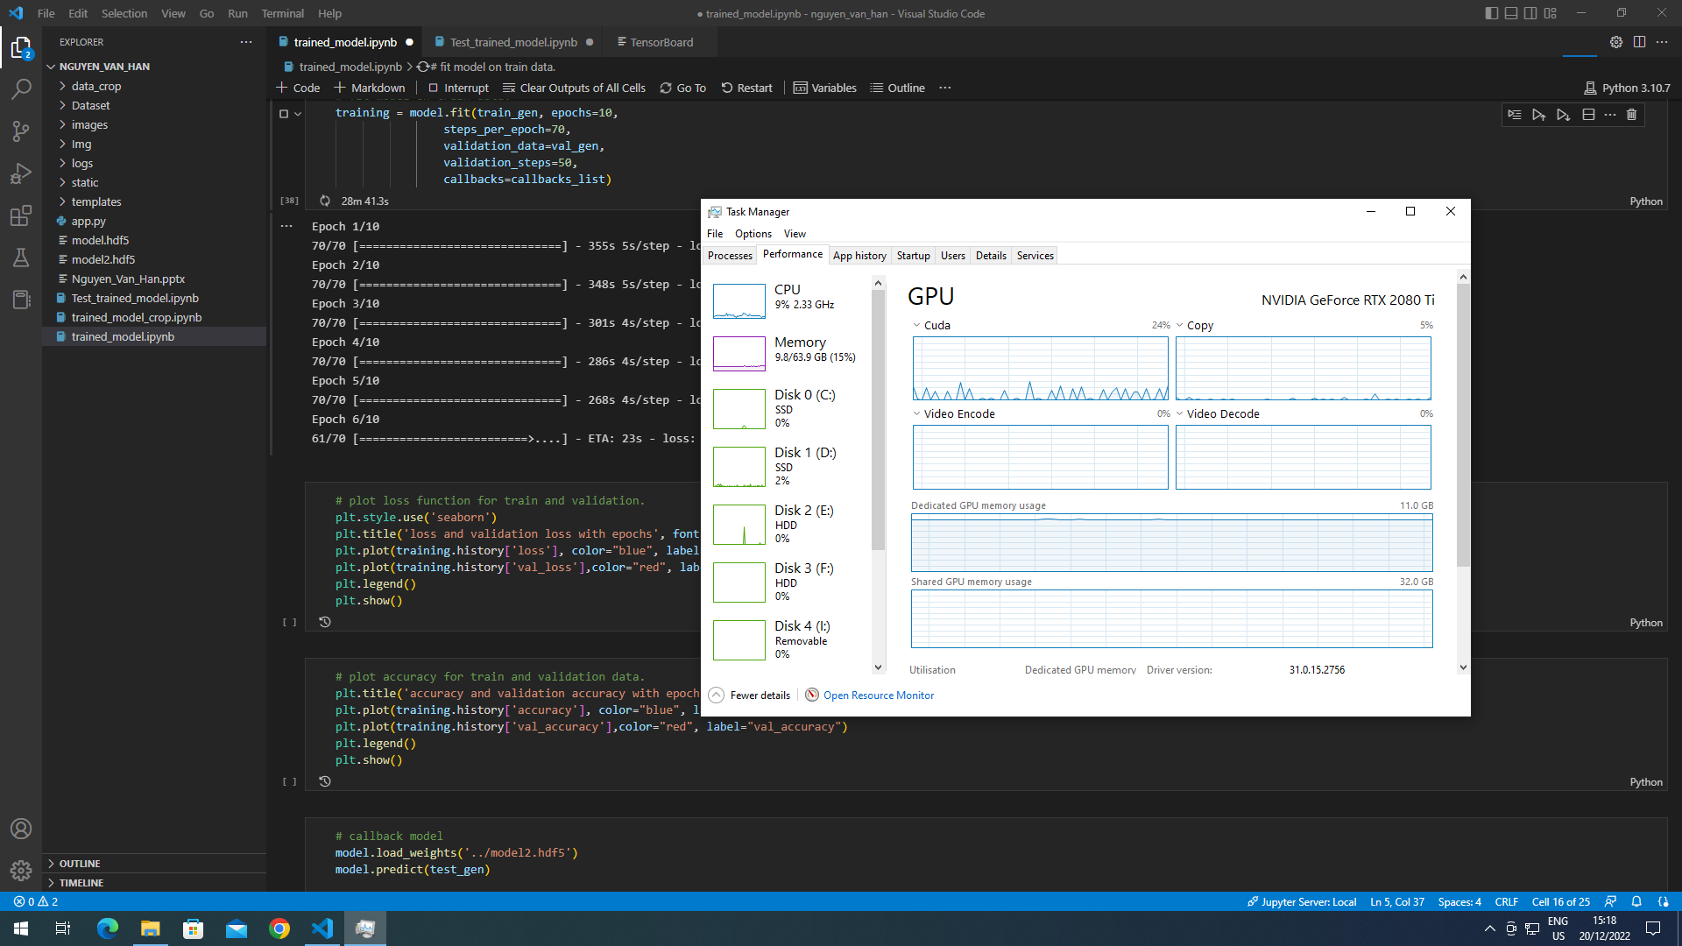

Slide 16
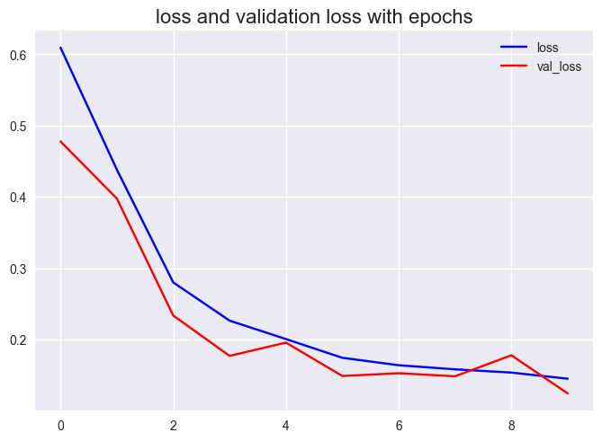
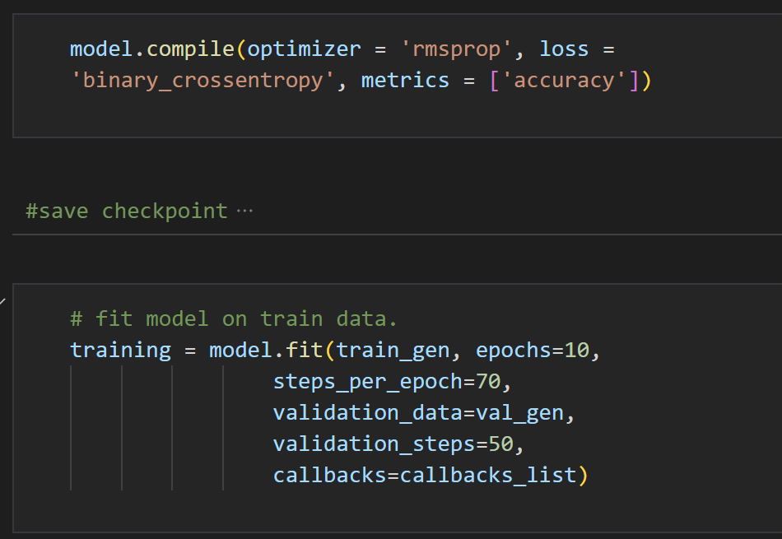
3. Make a CNN model and train model
Train model

Slide 17
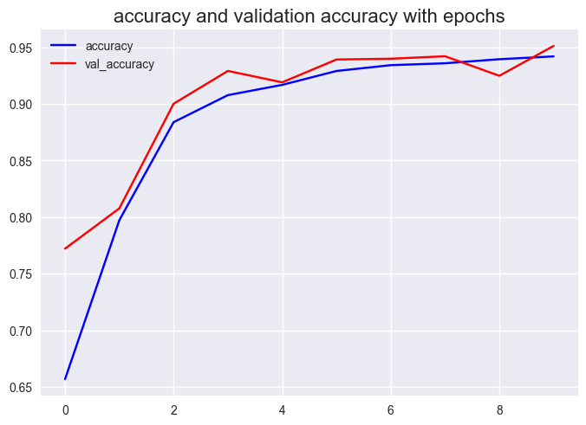
3. Make a CNN model and train model
Train model

Slide 18
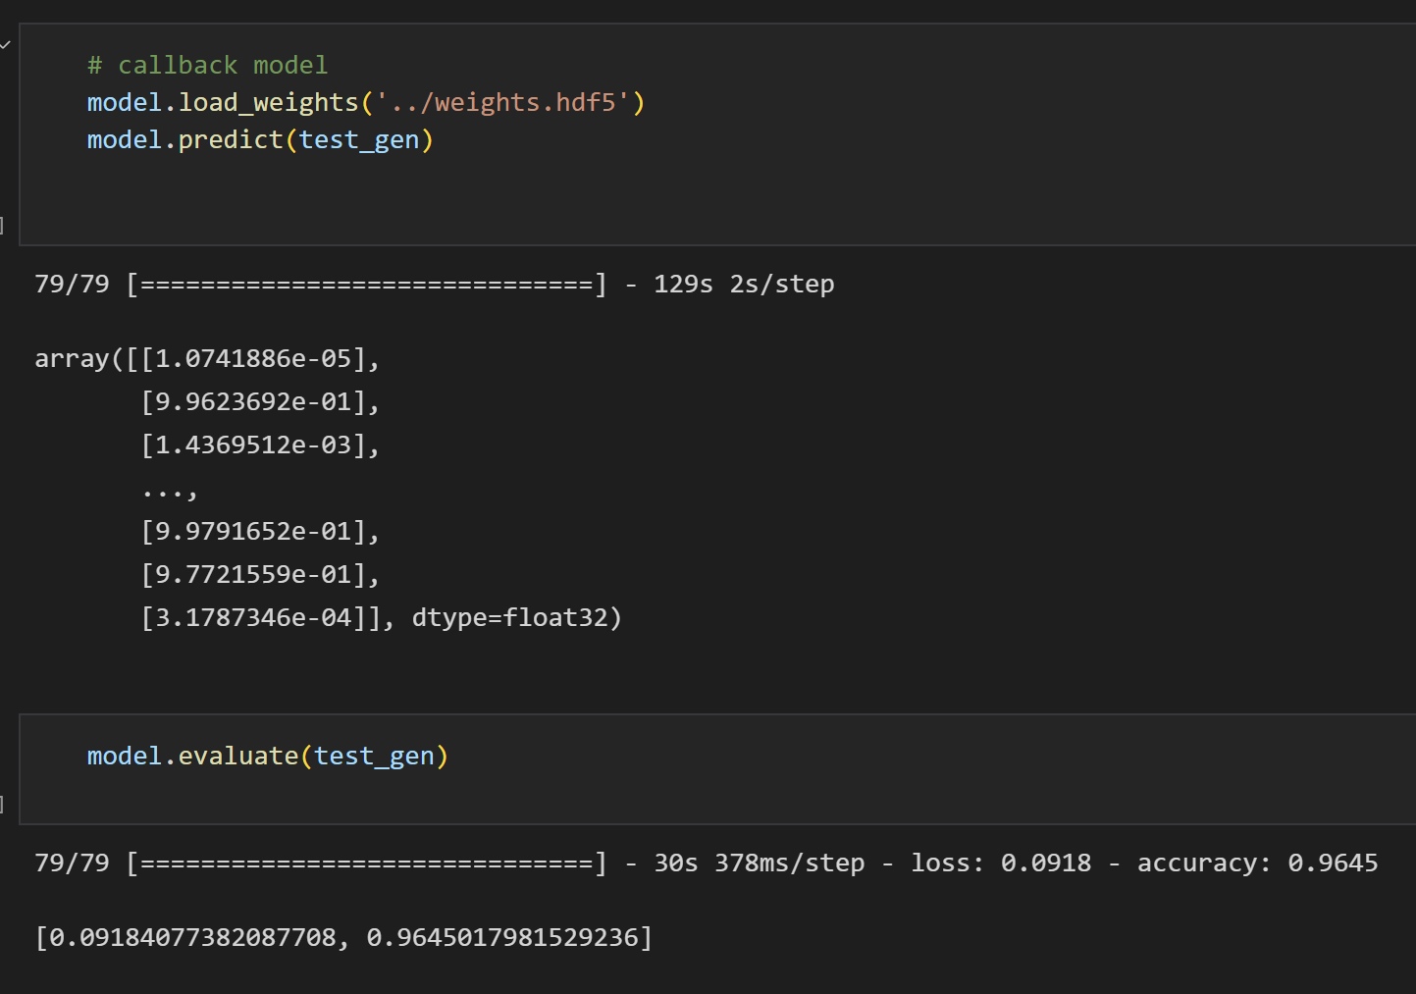
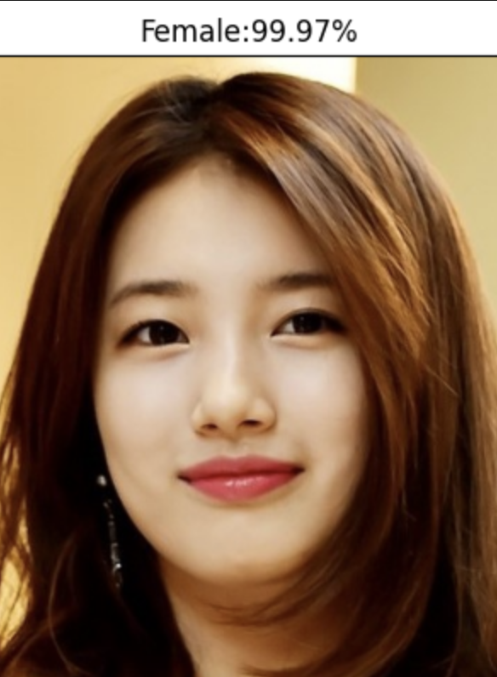
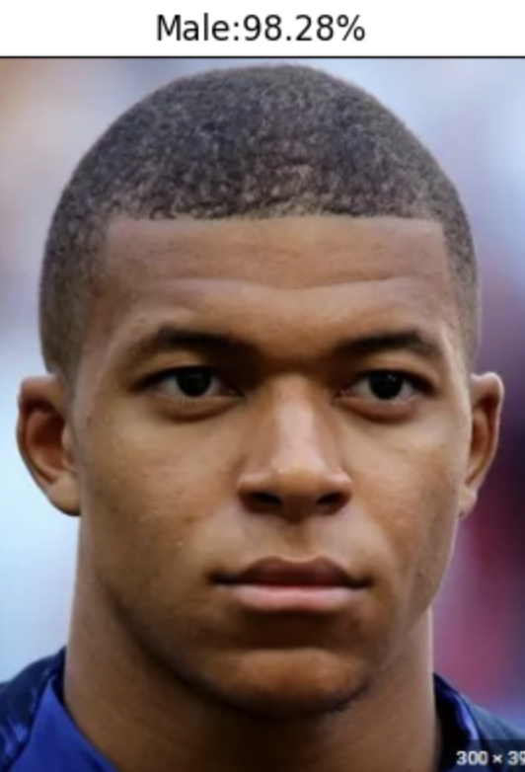
4. Evaluating the performance of a CNN model
Test Accuracy: 96.4 %
Test Loss: 0.093

Slide 19

5. Develop Web Application with Flask

Slide 20
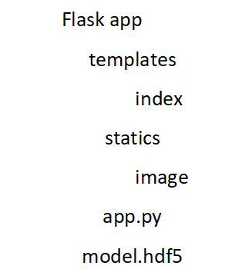
5. Develop Web Application with Flask
Components
FLASK
HTML
Bootstrap
CSS
Create all html files
Create all static files like css, js,
images, etc
Main flask file
Trained model

Slide 21
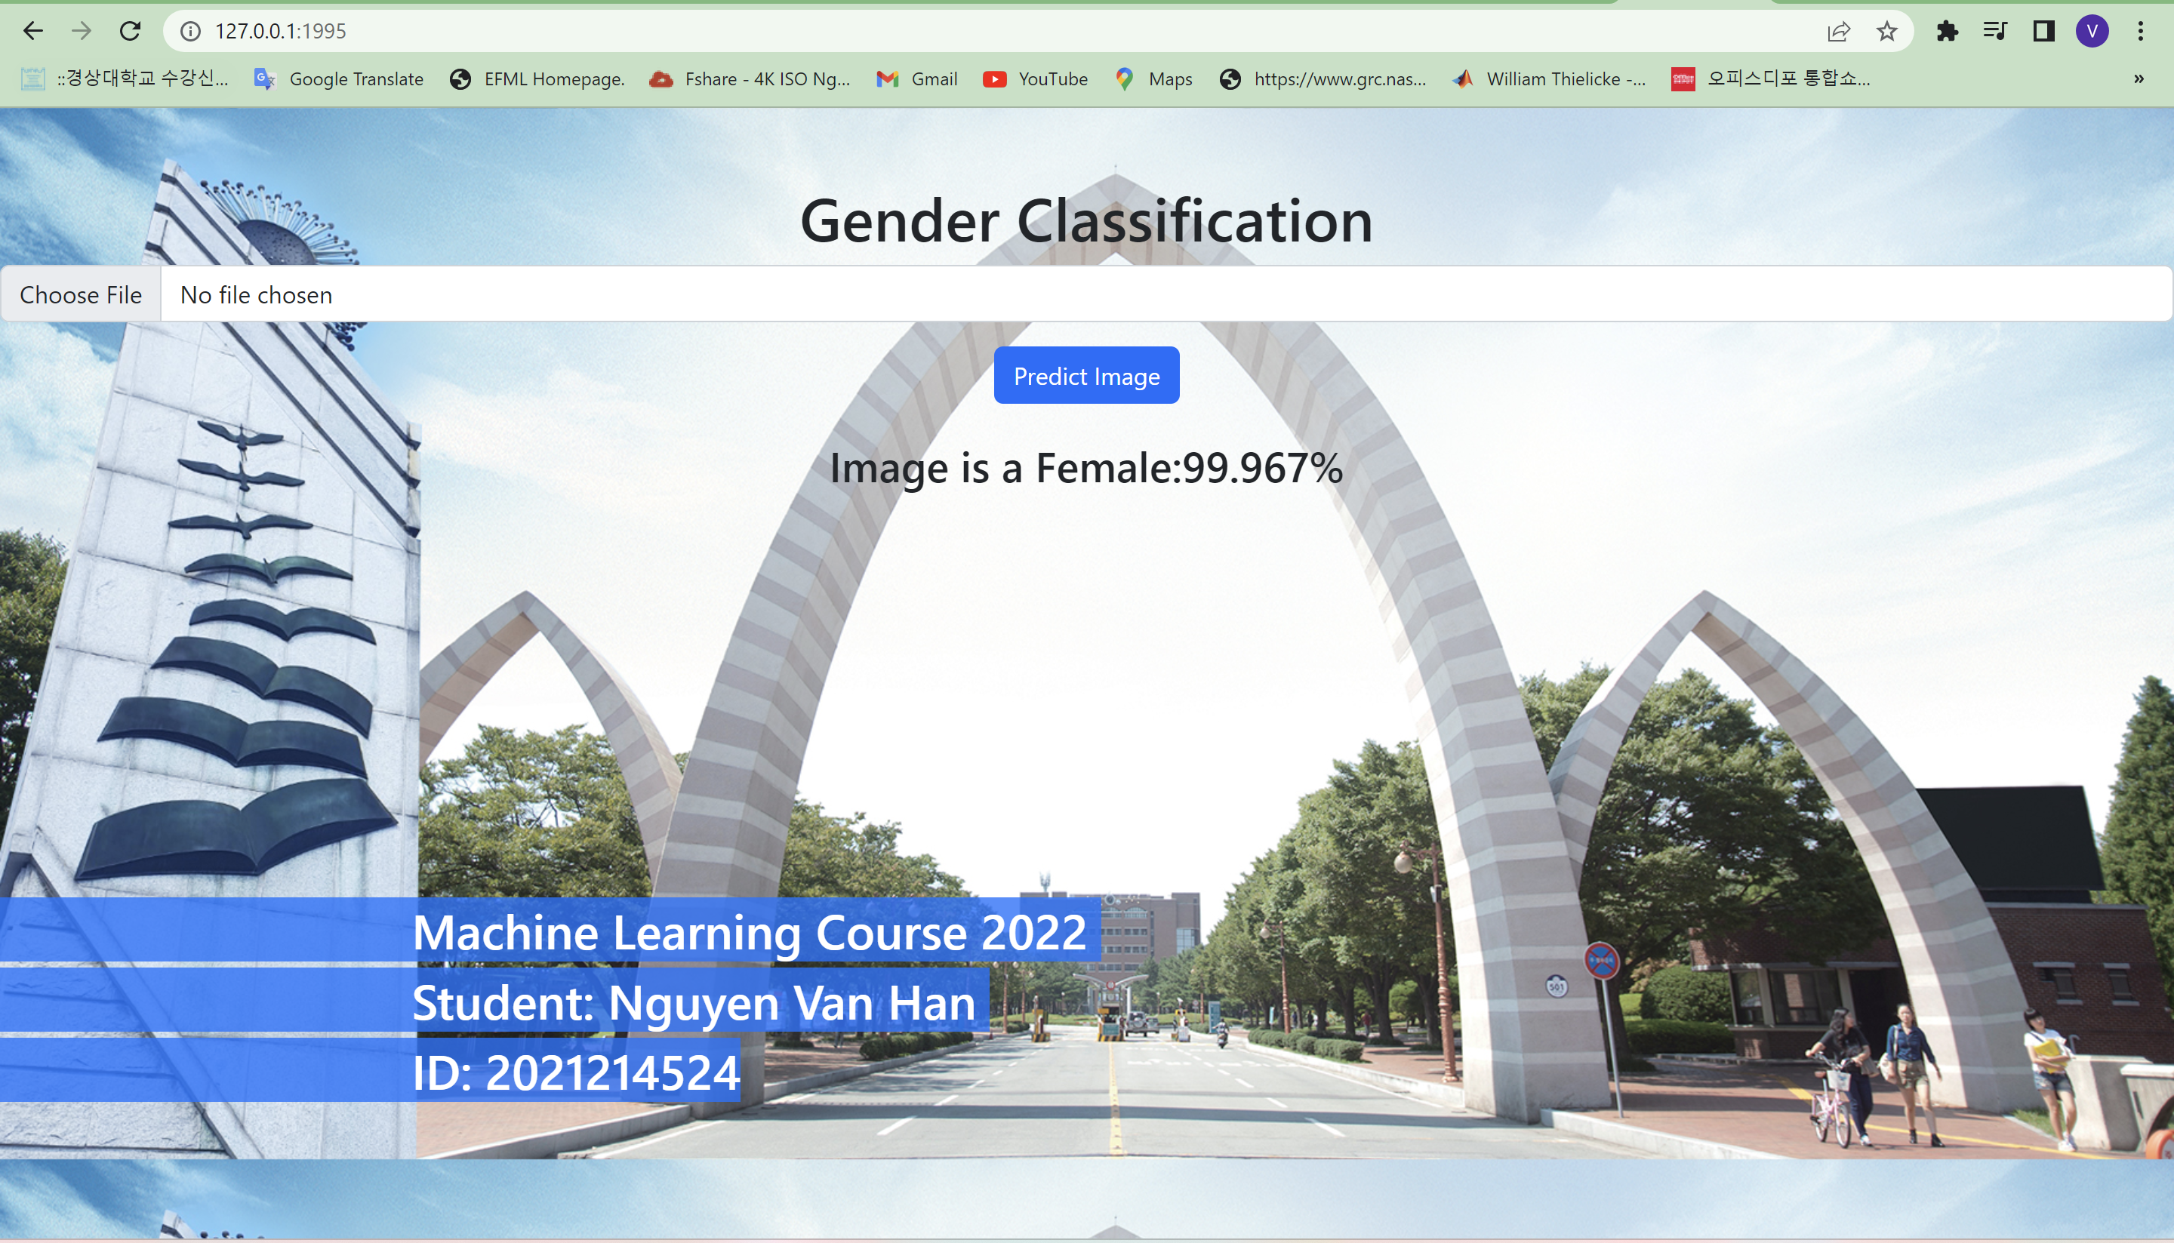

Slide 22
6. Conclusion
using a Convolutional Neural Network (CNN) can be an effective method for classifying gender based on images. CNNs are able to learn and extract features from images, allowing them to accurately classify different classes such as male or female. However, it is important to ensure that the training data used to train the CNN is diverse and representative of the population to avoid biases in the model. It is also important to consider the ethical implications of using CNNs for gender classification, as it can potentially perpetuate harmful stereotypes and discrimination. Overall, while CNNs can be useful tools for gender classification, they should be used with caution and consideration of their potential impacts.

Slide 23
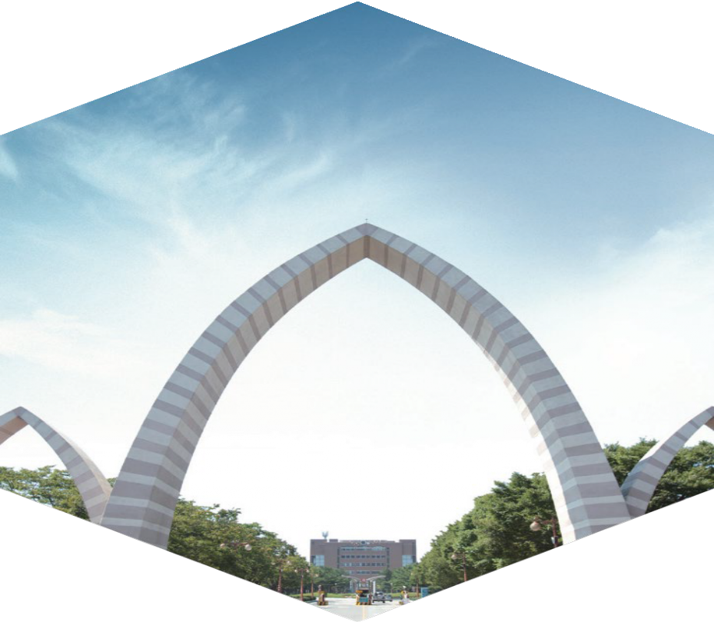
Thank you

Slide 24
the rmsprop optimizer is used to train the model. The rmsprop optimizer is a variant of stochastic gradient descent (SGD) that uses an adaptive learning rate that is based on the average of the recent gradients of the model. The learning rate is adjusted automatically by the optimizer during training, based on the statistics of the gradients of the model.

Slide 25
the model is configured to use the rmsprop optimizer, the binary_crossentropy loss function, and the accuracy metric. The rmsprop optimizer is a variant of SGD that is well-suited for training deep neural networks. The binary_crossentropy loss function is a common choice for binary classification tasks, where the goal is to predict a binary outcome (e.g., 0 or 1). The accuracy metric is a common choice for evaluating the performance of a classification model, as it measures the percentage of correct predictions made by the model.

